Slide 1
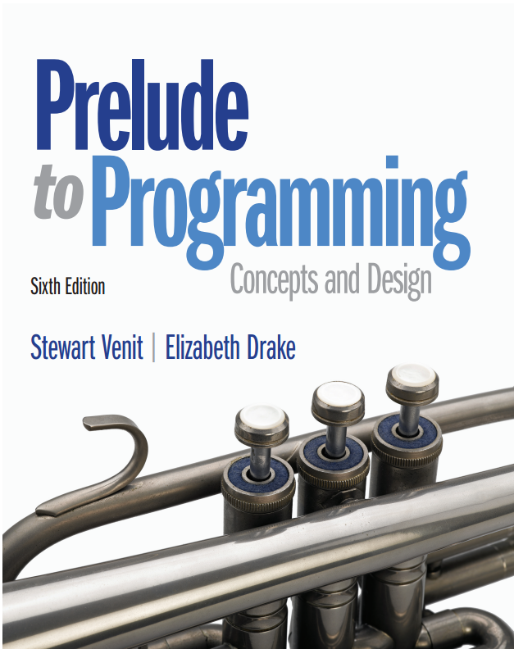
Prelude to Programming
Sixth Edition
Chapter 6
More About Loops and Decisions
Copyright © 2015, 2011, 2009 Pearson Education, Inc. All Rights Reserved
Notes:
If this PowerPoint presentation contains mathematical equations, you may need to check that your computer has the following installed:
1) MathType Plugin
2) Math Player (free versions available)
3) NVDA Reader (free versions available)

Slide 2
6.1 Combining Loops With If-Then Statements
By combining loops and decision structures, programs become much more complex.
Loops can be nested inside selection structures and selections can be nested inside loops.
Loops can be nested inside other loops.
Using multiple combinations of these structures allows for limitless possibilities!

Slide 3
Exiting a Loop Early
One reason to nest a selection structure inside a loop is to allow the loop to end before the test condition has been met for any reason. For example:
If the user has entered an incorrect value that would cause an error
If the user has entered a required response and the program can continue without further iterations

Slide 4
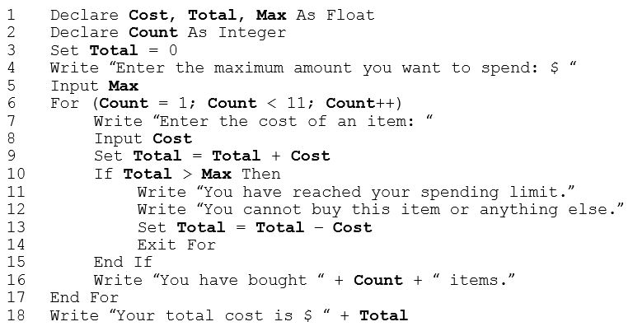
Example: Exiting the Loop When There’s No More Money

Slide 5
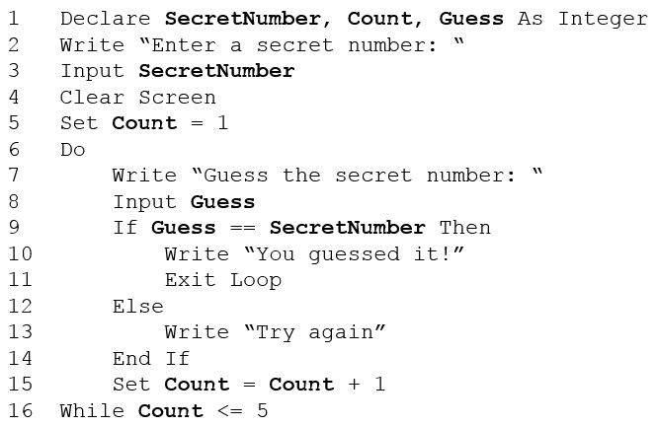
Example: The Guessing Game Using A Do…While Loop

Slide 6
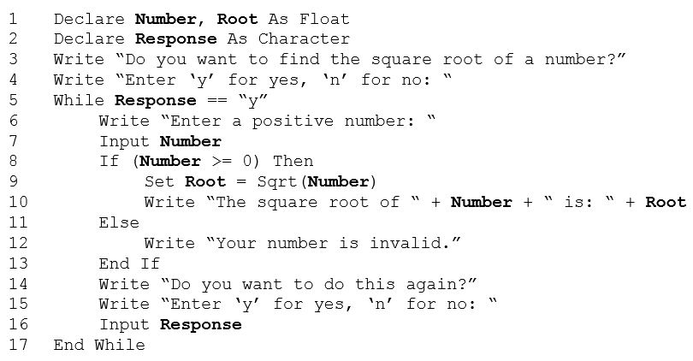
Example: Combining Loops, Decisions, And Validating Data Computing Valid Square Roots

Slide 7
6.2 Combining Loops and Decisions in Longer Programs
The example in the next slide shows how to keep track of how many positive numbers and how many negative numbers are input by a user.
Uses for this type of program:
Embed in a larger program to track various types of entries
Use by a college to enter demographic information on students
Use by a business to track number of items purchased that were above or below a certain cost

Slide 8
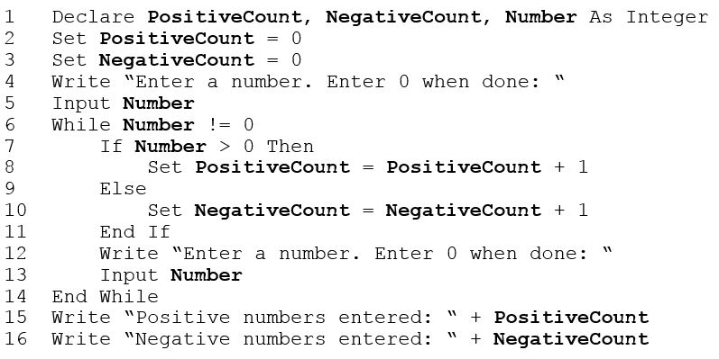
Example: Keeping Track of User Input

Slide 9
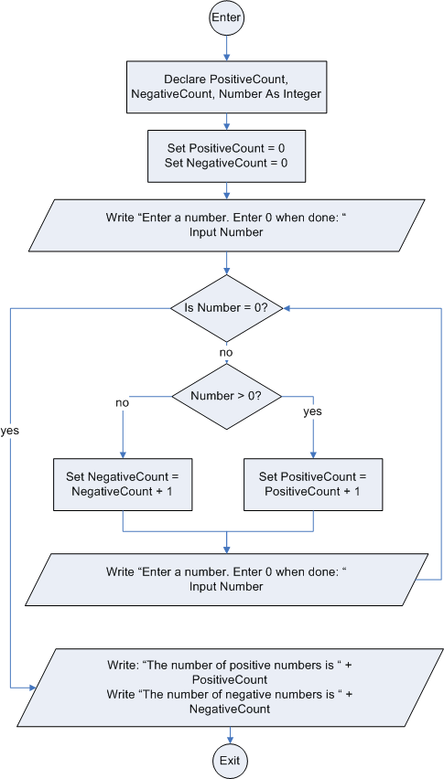
Flowchart Using a Selection Structure with a Loop to Keep Track of the Number of Positive and Negative Numbers Entered

Slide 10
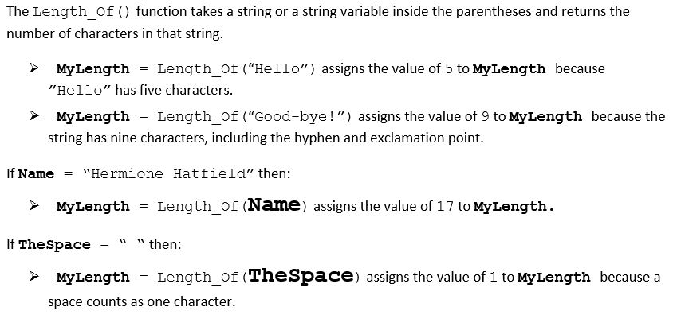
The Length_Of() Function

Slide 11
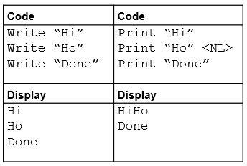
The Print Statement and the Newline Indicator <NL>
The Write statement indicates output to the screen with the assumption that each new Write statement would begin on a new line.
The Print statement indicates output to the screen, including the ability to concatenate variables and text. However, until the newline indicator is used, it is assumed that output from any subsequent Print statements will be on the same line. The newline indicator is <NL>.

Slide 12
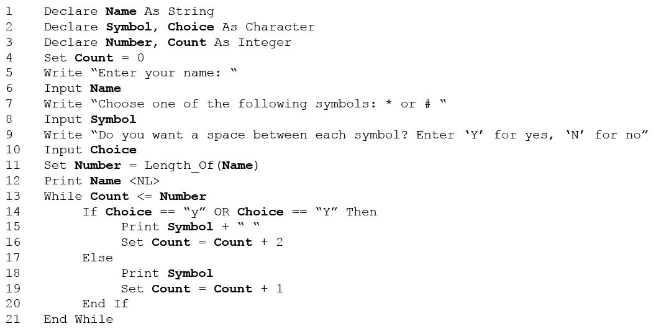
Using the Length_Of() Function for Formatting

Slide 13
6.3 Random Numbers
Random numbers are numbers whose values form an unpredictable sequence.
They have many interesting applications in programming.
One major use is to provide an element of chance in computer games.
They are also used to simulate situations or processes in business, mathematics, engineering, and other disciplines.

Slide 14
The Random()Function
Most programming languages contain a function that is used to generate a sequence of random numbers.
The name of this function and the way it works varies from language to language.
We define a function of the following form: Random() which generates a random number from 0.0 to 1.0 (including 0.0 but not 1.0).
To increase the range of random numbers generated, multiply Random() by any value.
To change the spread of the range, add an integer to the values generated.
Use the Int() or Floor() function to generate random integers.

Slide 15
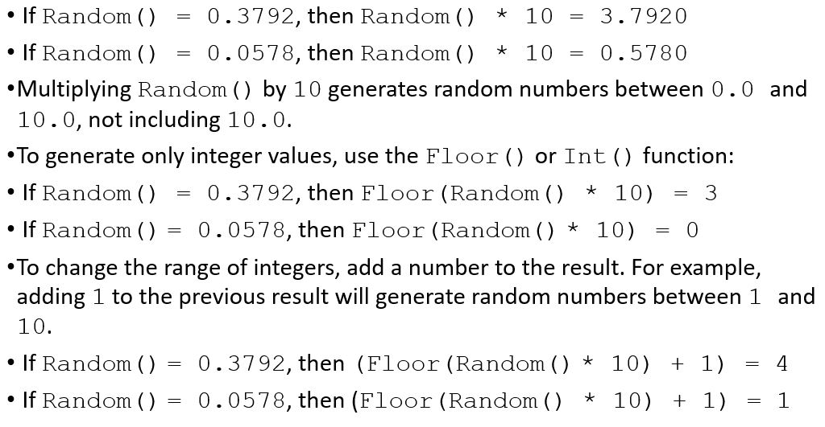
Examples of Random Numbers Using the Random() Function

Slide 16
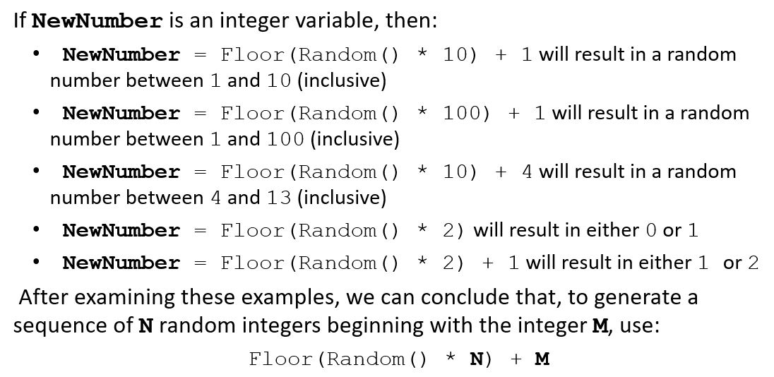
Generating Random Numbers in Various Ranges

Slide 17
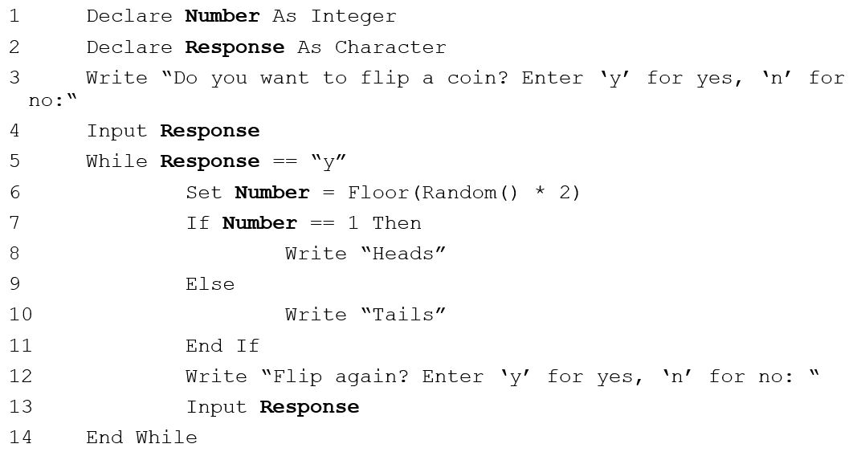
Example: Flipping a Coin

Slide 18
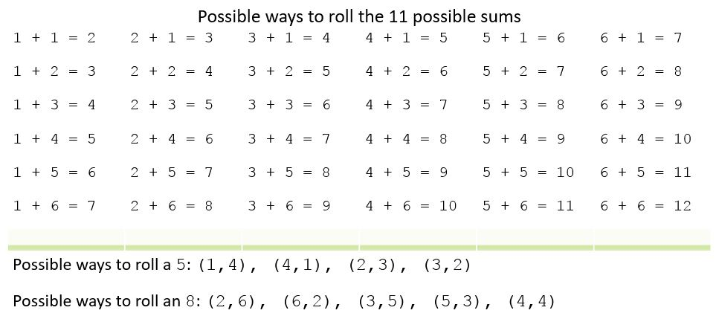
Example: Winning at Dice: What Number Should I Bet On? (1 of 2)

Slide 19
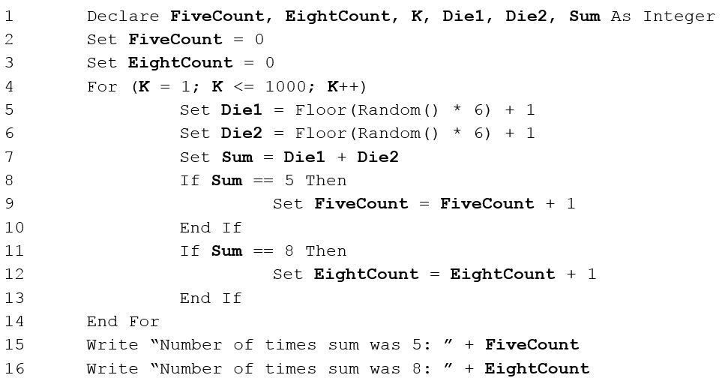
Example: Winning at Dice: What Number Should I Bet On? (2 of 2)

Slide 20
The Algorithm for a Pseudorandom Number
A computer doesn’t understand, “Pick any number between 1 and 20.”
A computer must receive instructions from a program.
Random numbers are often produced by means of a mathematical algorithm.
A mathematical algorithm is a formula that instructs the computer how to pick some number in a specified range.
An algorithm requires some beginning value to manipulate.
This starting number is the seed value.

Slide 21
The Seed for a Pseudorandom Number
If the same seed is used each time, the numbers generated are not really random. Such numbers are called pseudorandom.
If the starting value of the algorithm never changes, the same sequence of numbers will be produced each time the program is executed. This may be useful for debugging purposes.
The programmer must force the computer to use a different seed on each run so that the random numbers produced will be unpredictable.
use a seed that is not predetermined, like the number of milliseconds since the beginning of the current year
it will only occur once a year
forces a random number generator to start with a different seed each time

Slide 22
6.4 Nested Loops
When one loop is contained entirely within another we say that they are nested loops.
The larger loop is called the outer loop
The one lying within it is called the inner loop
It is often difficult to follow the logical sequence of steps when nested loops are implemented.
It is very important to be able to walk through (desk check) the pseudocode with paper and pencil, carefully writing down the values of each variable at each step.

Slide 23
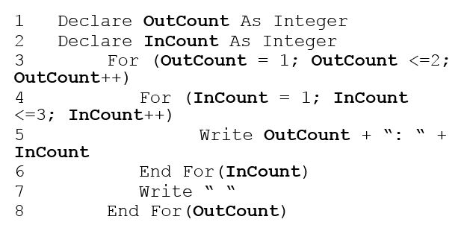
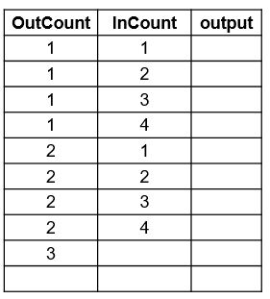
Example

Slide 24
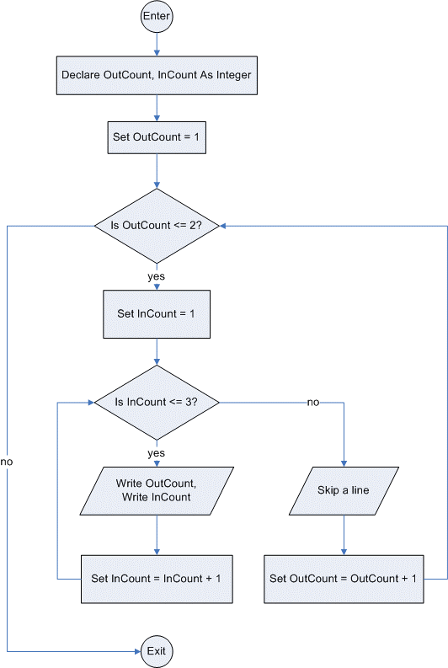
Flowchart for the nested loops on the previous slide

Slide 25
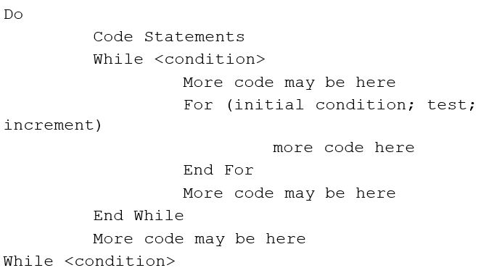
Nesting Other Kinds of Loops
Any style of loop may be nested. Each nested loop must be indented to indicate which statements are controlled by which looping construct.

Slide 26
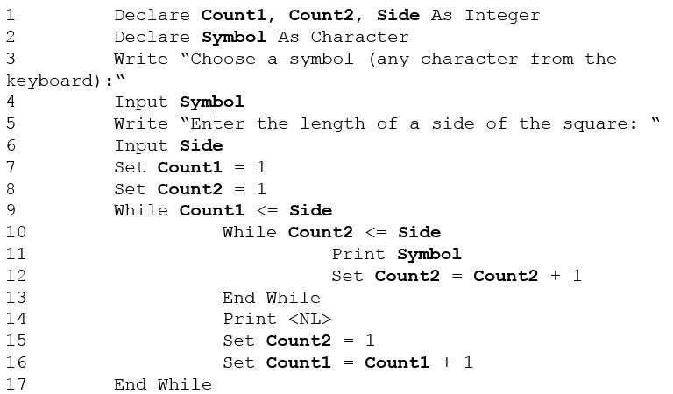
Example: Drawing Squares

Slide 27
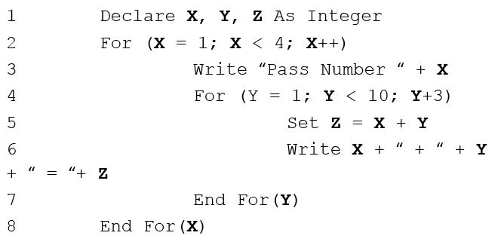
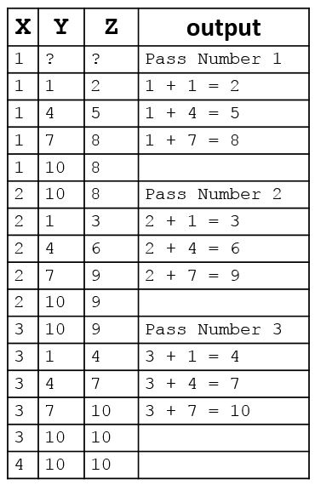
Mind Games: Workout #1

Slide 28
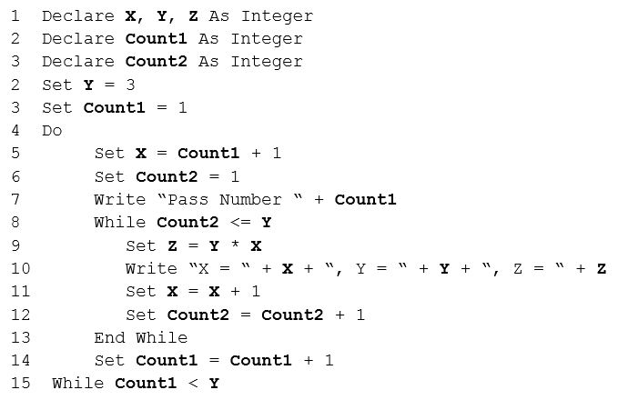
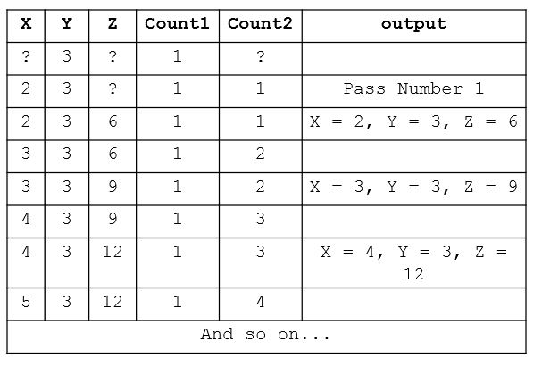
Mind Games: Workout #2

Slide 29
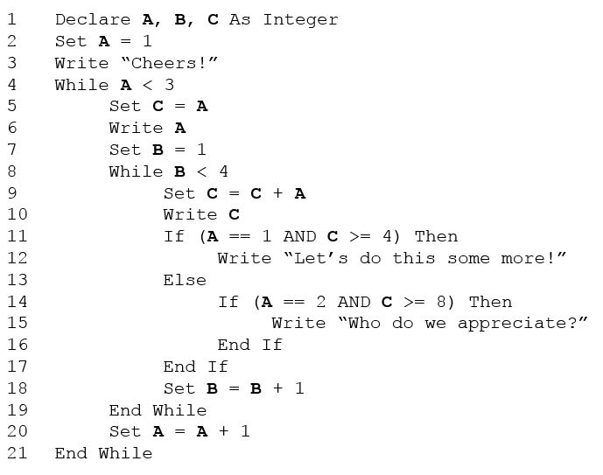
Mind Games: Workout #3

Slide 30
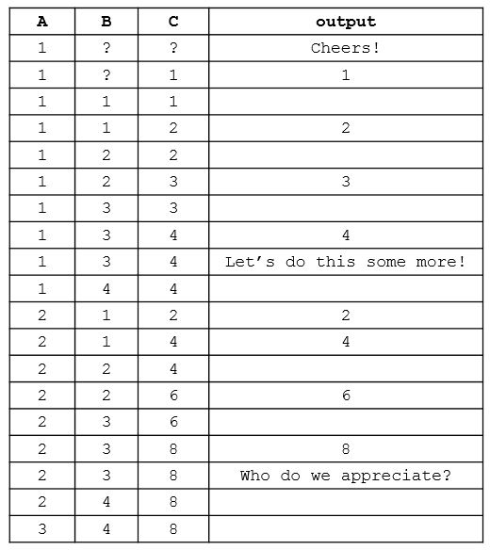
Mind Games: Workout #3 Follow Along…

Slide 31

Copyright

